Slide 1
Team Eagles
EDA On Netflix Dataset
CS504-001 Team Project
Spring 2022

Slide 2
Sprint | Milestone Goals | Presentation
0 - Team Formation | Team Members & Roles Brief description of Team Problem Request WebEx with instructor | Week 1
1 - Problem Definition and Project Plans | Problem (decision) defined Understanding of complexity Potential data source identified Potential analytics identified Project schedule defined Participant roles assigned Risks identified and mitigation plan | Week 2
2 - Data Sets | Data located and accessed Initial processing underway Risks identified and mitigated | Week 3
3 - Analytics/algorithms | Algorithms defined and coded Initial applications completed Risks identified and mitigated | Week 5
4- Visualizations | Visualization concepts defined Visualization implemented Risks identified and mitigated | Week 7
Final Presentations | Project components completed Project components integrated Project supports final decision Presentation made | Week 8

Slide 3
Team Eagles
Team Roles:
Scrum Master – George
Product Owner– Beza
Developer –Pranav
Tools
Team will use R Studio and Jupyter Notebook.
Will use YouTrack for tracking all Sprints
Microsoft 365 for meetings and File Sharing
Team can use GitHub to store code
Business Rhythm:
Review tasks for the sprint
Complete assigned work for the sprint
Show the professor the progress we’ve completed weekly

Slide 4

Sprint Tracking
Tools Used
Youtrack
Microsoft 365

Slide 5

Background
Netflix is one of the most popular online movie/TV show streaming company.
Netflix has been a data-driven business since the beginning.
Netflix has gained its popularity using advanced data and analytics
Technology used: Streaming Analytics
Popularity of streaming analysis in the movie industry

Slide 6
Data Analytics Problem
Problem Selection –In this project, we will be taking a closer look at a Netflix dataset to perform an exploratory data analysis and give appropriate business decisions.
Scope – Create visualizations using R to identify trends and correlations between attributes.
Data – Dataset contains 7,787 rows and 12 columns.
Downloaded from Kaggle.com

Slide 7
Project Goals
Exploratory Data Analysis
Gain deeper insight on a data collected from Netflix customers
Meet the ongoing customer demands
Answer critical business questions

Slide 8
Problem Definition
Initial Story -
"As a client, I would like to gain deeper level of insights and enhance viewership, identify errors, and respond faster to identified risks and manage them appropriately”
“As service providers, we want to identify areas of improvement and potential growth opportunity ”
“As a customer, I would like to gain deeper level of insights and enhance viewership, identify errors, and respond faster to identified risks and manage them appropriately”
“As a User, I want to see more contents and variety of selections of movies and shows in my account .”

Slide 9
Potential Data Sources
The first dataset was gathered from Kaggle.com, the dataset contains over 69K records of TV Shows and films from different countries across the world.
Link to the dataset: https://www.kaggle.com/datasets/dhruvildave/netflix-top-10-tv-shows-and-films
To mitigate the risks that we have identified with the dataset being not feature rich we supplemented the original dataset with another set of data which is also obtained from Kaggle.
Link to the dataset: https://www.kaggle.com/datasets/shivamb/netflix-shows

Slide 10
Potential Analytics
Should Netflix Produce more TV shows or Movies
Observation of growth in content over the year
Identify which countries contribute more content
Identify the distribution of movie duration (identify the correlation between those features)
Identify the correlation between attributes
Build an interactive Dashboard using R shiny or R Markdown
Notes:
Suggest we concentrate on Metadata and NLP and NOT Externals other than what results from associations between metadata and content

Slide 11
Data Set Description
Data Set Name
Netflix Titles dataset on TV Shows and Films
Data Set Location:
Kaggle
Data Set Description
This dataset contains data collected from Netflix starting from the 3rd of Jul 21 – 26th of Mar 22
This data set is updated weekly
Data Set License
LICENSE
Database: Open Database, Contents: © Original Authors

Slide 12
Data Set Description
Show ID: Each show/movie is assigned a show id for ease of access
Type: categorizes the entry in to either a movie or a TV shows
Title: The title of the movie or TV show.
Director: Contains names of the director of that particular show/movie
Cast: lists the names of casts
Country: The country where the show/movie was produced
Date Added: describes the date when it was added to Netflix
Release Year: describes the year when the show was released

Slide 13
Data Set Description
Rating: the ratings of the show are listed below.
Rated G: General audiences – All ages admitted.
Rated PG: Parental guidance suggested – Some material may not be suitable for children.
Rated PG-13: Parents strongly cautioned – Some material may be inappropriate for children under 13.
Rated R: Restricted – Under 17 requires accompanying parent or adult guardian.
Rated NC-17: Adults Only – No one 17 and under admitted.
Duration: the length of the show in minutes.
Listed In: Describes under which genre the show or movie is being listed.
Description: A brief description of the movie or TV show.
One of the main reason why we used this data set is because it is suitable for our project objective and has more observation than other data sets available.

Slide 14
Data Sources
Data Proprietary or License Concerns
This data is available to the public and there are no concerns for utilizing this dataset.

Slide 15
Data Sources
Data Source Name
Netflix
SOURCES
https://www.netflix.com/
https://www.kaggle.com/datasets/shivamb/netflix-shows
https://www.kaggle.com/datasets/dhruvildave/netflix-top-10-tv-shows-and-films
COLLECTION METHODOLOGY
Data provided by Netflix
Netflix collects data such as viewing day, time, location and device used, from each user.
Data is collected based on the legal consent of the users
Volume of Data Available
7,787 rows and 12 columns

Slide 16
Data Quality
Accuracy
Reliability
Consistency
Completeness
Integrity
Timeliness
Uniqueness

Slide 17
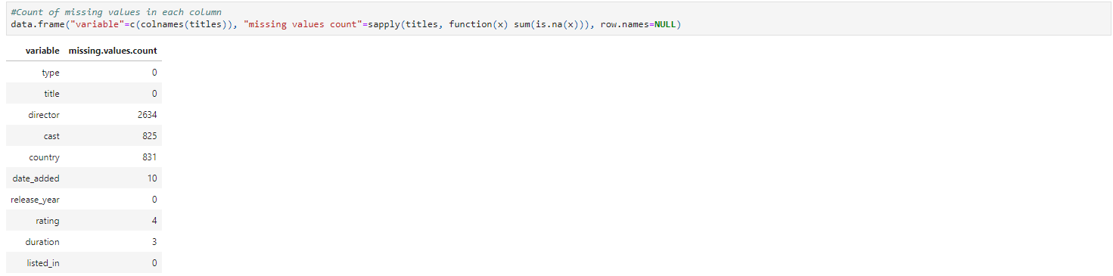
Missing Value Count

Slide 18
Risks and Planned Mitigations
Risk: Dataset appears big in terms of records, but it is sparse in terms of metadata. Missing and misplaced values in the dataset.
Probability: medium
Impact: medium
Mitigations: Detailed data cleaning
Risk: Failure to obtain appropriate data
Probability: low
Impact: high
Mitigation:
Pursue Other data sources
Risk: Analytic methods fail
Probability: high for any one method-data combination
Impact: medium
Mitigations:
Prototype early
Apply multiple techniques
Integrate
Assess the best fit model

Slide 19
Algorithm Description
Exploratory Data Analysis on Netflix Data Set
Exploratory Data Analysis (EDA) is a way of evaluating datasets to summarize their essential properties, generally using visual methods, in data mining. Before beginning the modeling work, EDA is used to see what the data can tell us.

Slide 20
Data Clean Up
Data Cleanup involves the following activities
Remove uninformative columns like “show_id” and “description”
To get the count of missing values in each column
Director, cast, country, release year, duration are having missing values
Since rating is a categorical variable, with 14 different values this attribute can be filled on the basis of mode
For movies and TV shows which do not have a Director, Country and Cast, fill NAvalues with 'No Director', 'No Country', 'No Cast’
There are 3 values in duration which are blank, but those values are present in the ratings column
Date value cannot be inputted in anyway and we cannot drop those rows because we would lose data

Slide 21
Algorithm Application
What programming language ?
R Programming
R is a strong tool for data visualization, time series analysis, classification, clustering, and more.
It's also an outstanding programming language for sophisticated statistical and graphical modeling.
Other tools, Jupyter notebook utilized through Anaconda Navigator to access R studio.

Slide 22
Algorithm Application
Lubridate
Dplyr
Ggplot2
Tidyverse
Plotly

Slide 23
Packages Used
tidyverse
Plotly
lubridate
dplyr

Slide 24
Code Size and Complexity
200 odd lines of code
Interactive dashboard with R Markdown or R shiny
Code complexity : Medium
The implementation would be tested by the developer on the project

Slide 25

Visualization

Slide 26
Questions to Answer
Should Netflix Produce more TV shows or Movies
Observation of growth in content over the year
Identify which countries contribute more content
Identify the distribution of movie duration (identify the correlation between those features)
Identify the correlation between attributes

Slide 27
Visualization Description

Slide 28
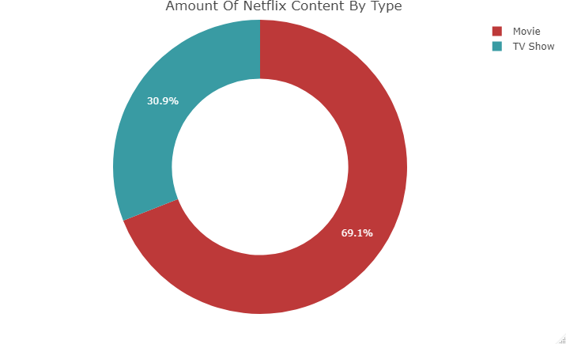
1. Donut Chart

Slide 29
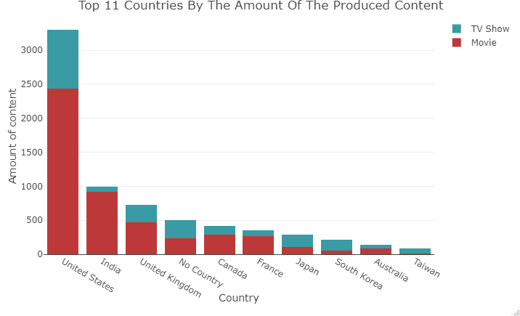
2. Stacked Bar Chart

Slide 30
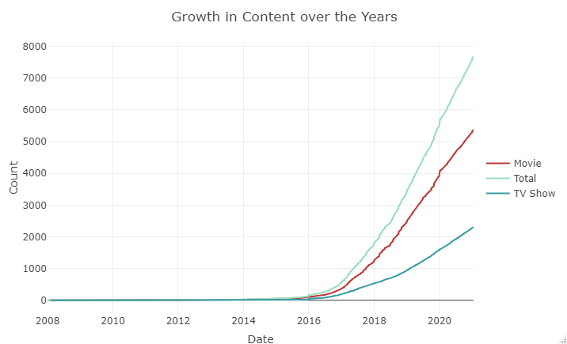
3. Line Graph

Slide 31
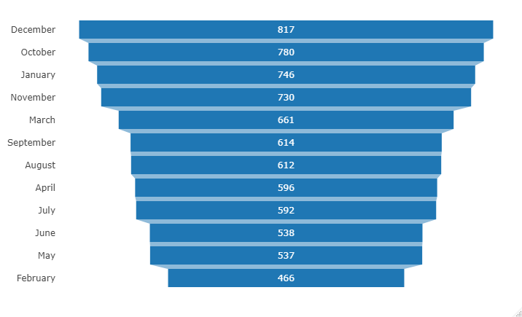
4. Funnel Charts

Slide 32
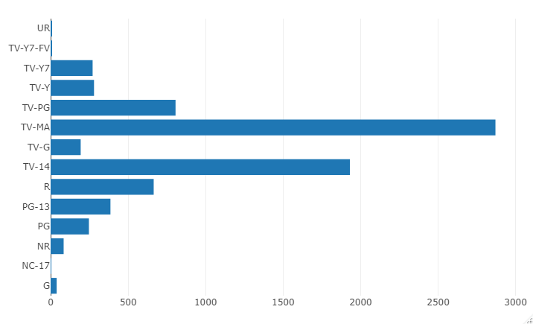
5. Bar Charts

Slide 33
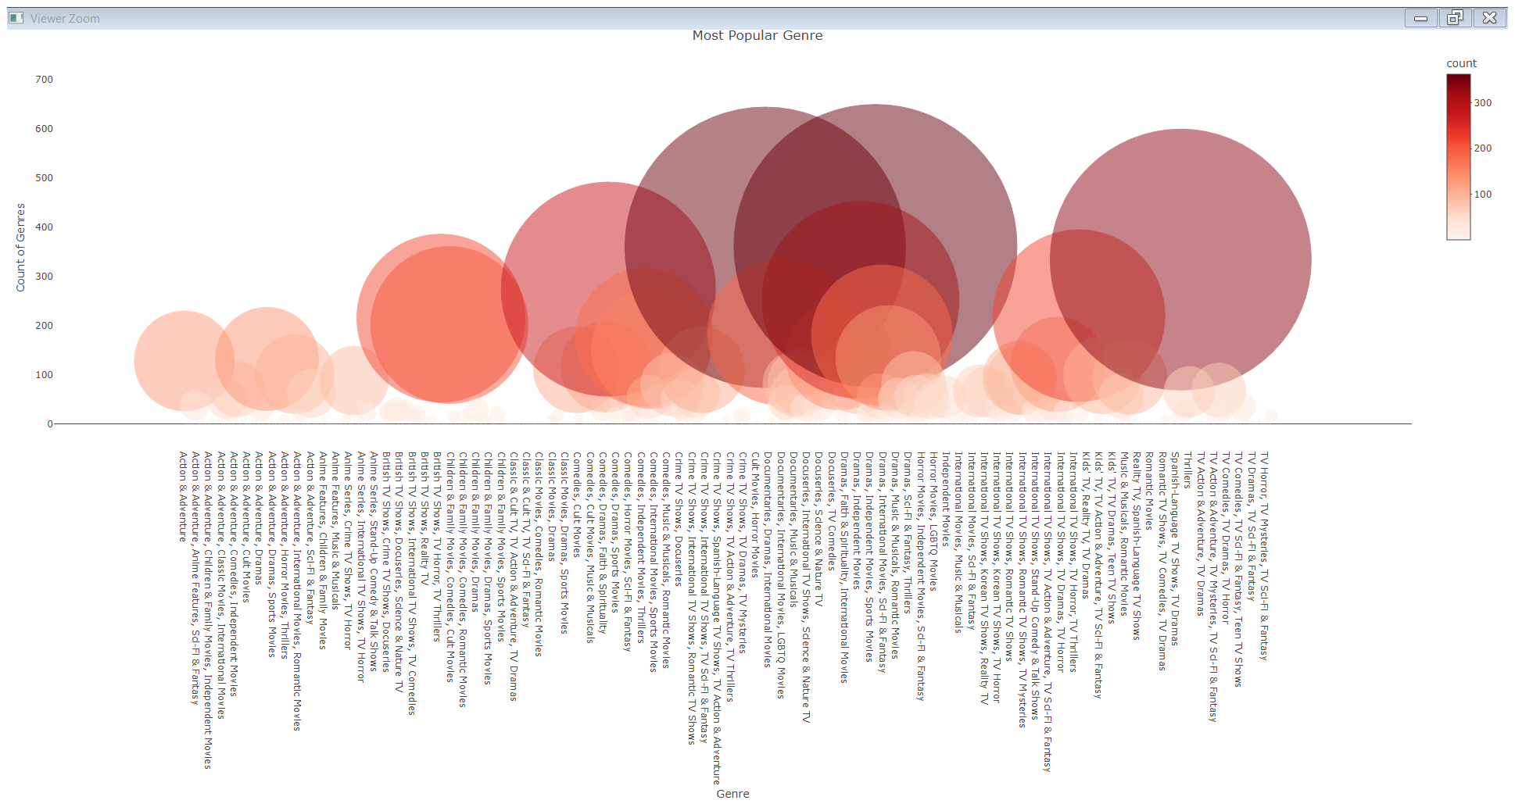
6. Bubble Charts

Slide 34
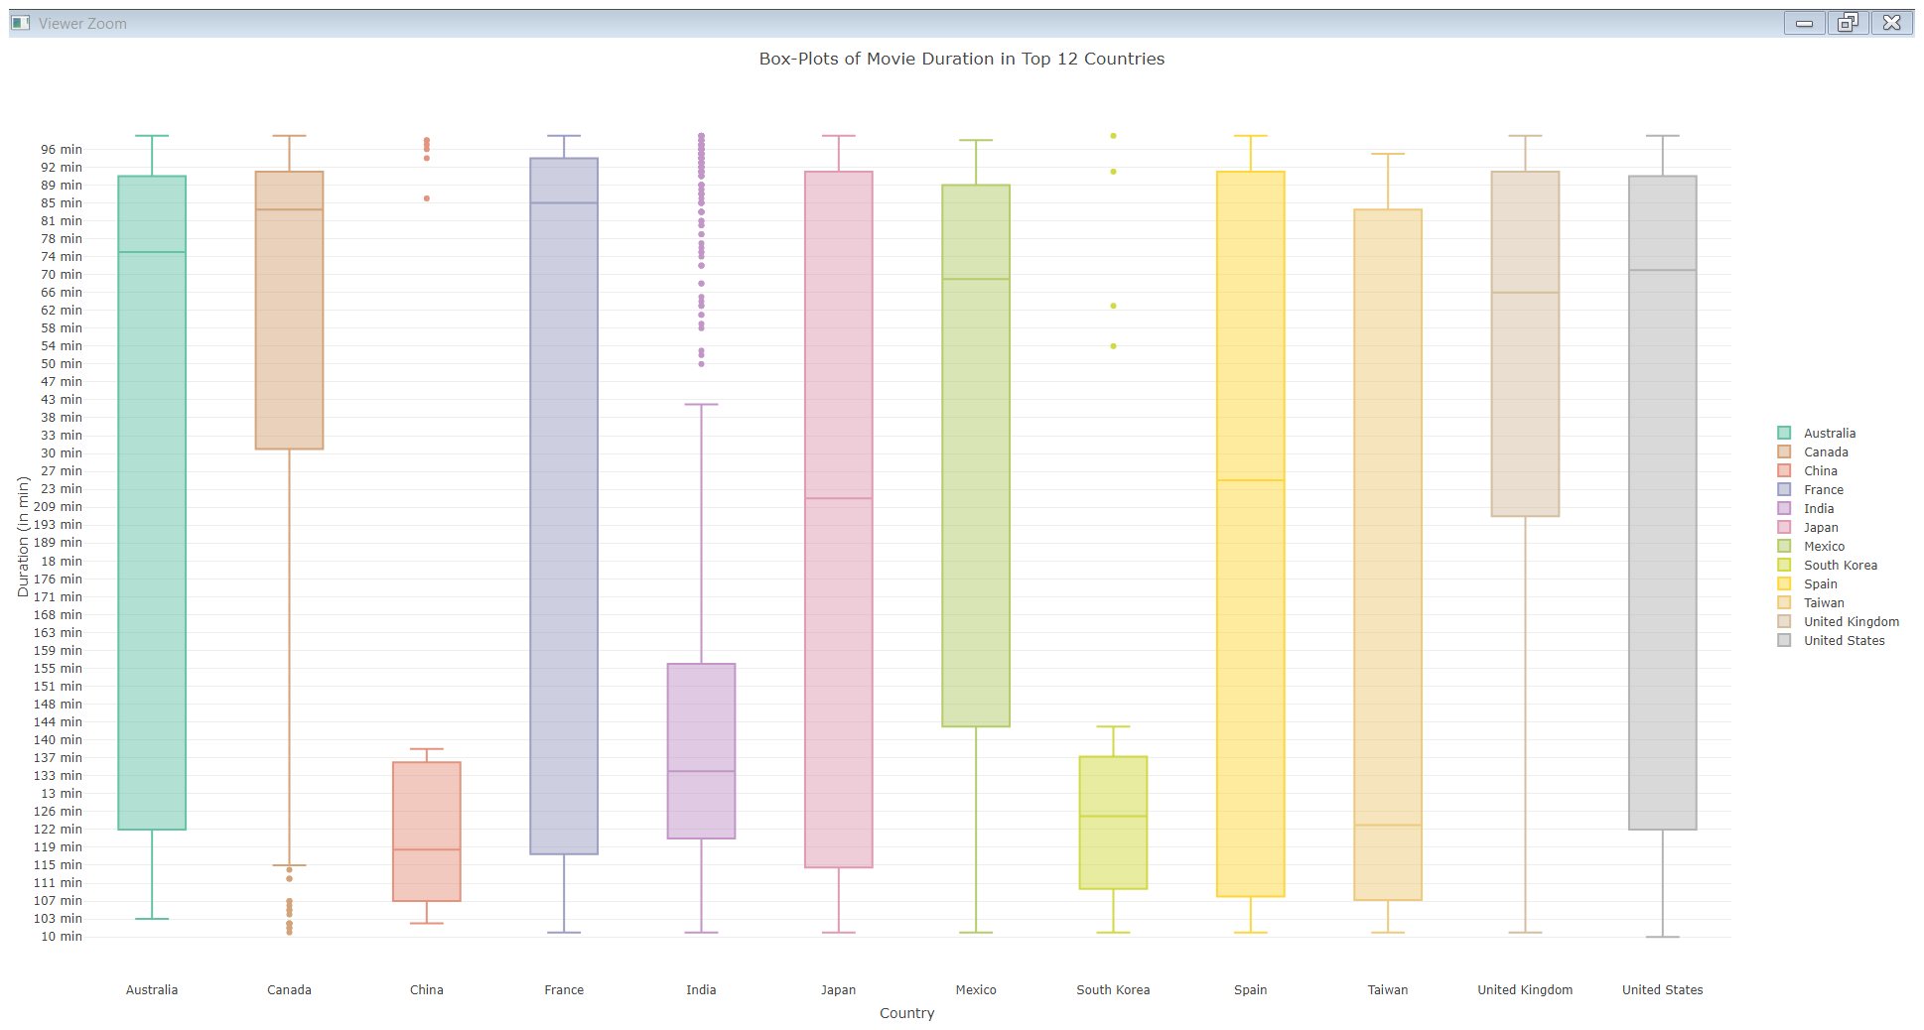
7. Box Plots

Slide 35
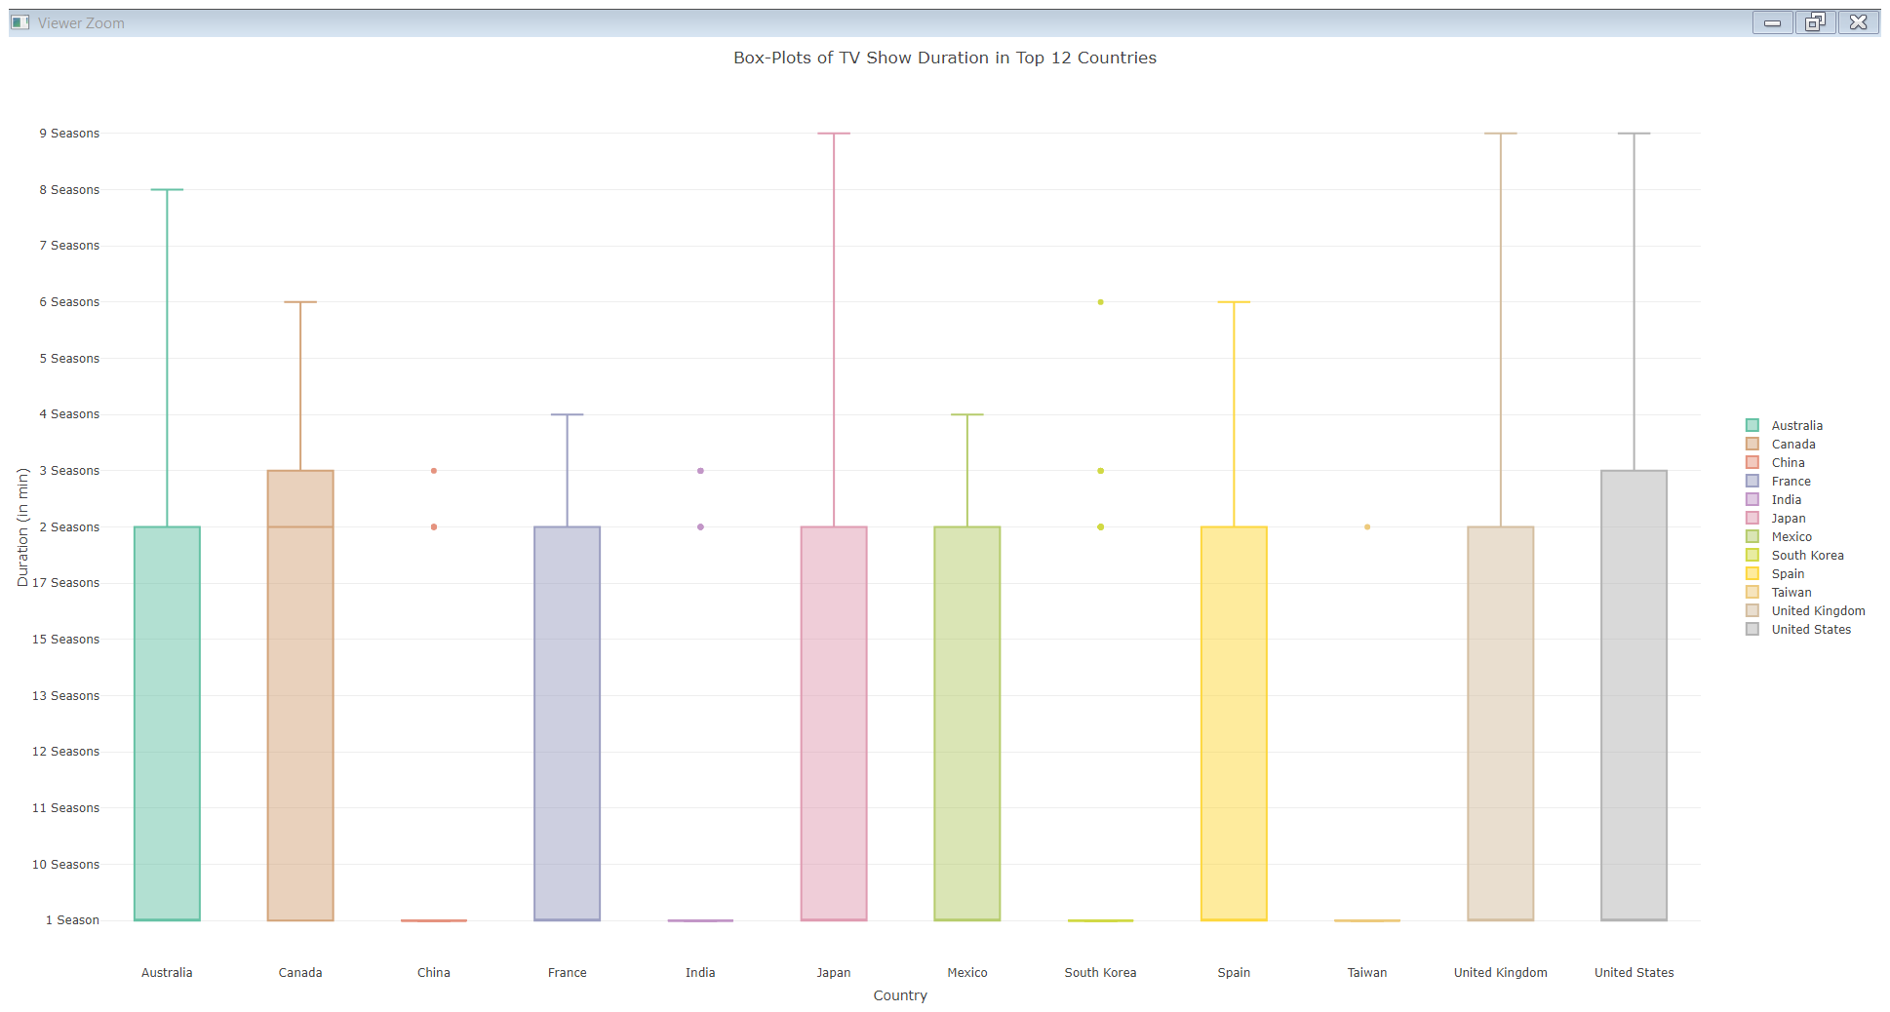
8. Box Plots

Slide 36
9. Interactive Dashboard – Flexdashboard
Built an interactive dashboard with Flexboard
Flexdashboard is an r Markdown file that can be combined with R Shiny to create reports and dashboards
The created dashboard or app was then published into shinyapps.io through API’s
Shinyapps.io - https://pranavc93.shinyapps.io/FlexDashboardNetflix/

Slide 37
Findings
On Netflix, movies make up 2/3 of the content, while TV shows make up the remaining 33%.
Most films and television shows are categorized TV-MA, with only a few exceptions designated NC-17.
During the month of December, Netflix distributes more contents.
United states contributes the most contents to Netflix

Slide 38
Future Work
we propose a movie recommendation system that can match the users search history

Slide 39

Summary
The increase in content has a direct relationship with the exponential growth of subscribers.

Slide 40

Questions

Slide 41

Thank you!

